Slide 1
ST 411/511: Methods of Data Analysis Winter 2023
Lecture 11
Monday, February 6, 2023

Slide 2
Today’s Outline:
t-test Resistance
Outliers
Transformations of data
Why?
How?
What do we learn?
‘Alternatives’ to t-test
Today: Wilcoxon Rank-Sum test introduction

Slide 3
Resistance of the t-test
Definition: A procedure is said to be resistant if the results do not change very much when just a few of the values in the sample(s) change.
Example: Suppose you had the following sample data:
4, 7, 9, 10, 15
What is the sample mean?
What is the sample median?

Slide 4
Resistance of the t-test
Definition: A procedure is said to be resistant if the results do not change very much when just a few of the values in the sample(s) change.
Example: Suppose you had the following sample data:
4, 7, 9, 10, 15
What is the sample mean?
What is the sample median? med = 9

Slide 5
Resistance of the t-test
Definition: A procedure is said to be resistant if the results do not change very much when just a few of the values in the sample(s) change.
Example: Now suppose the last observation is changed:
4, 7, 9, 10, 150
What is the sample mean?
What is the sample median?

Slide 6
Resistance of the t-test
Definition: A procedure is said to be resistant if the results do not change very much when just a few of the values in the sample(s) change.
Example: Now suppose the last observation is changed:
4, 7, 9, 10, 150
What is the sample mean?
What is the sample median? med = 9

Slide 7
Resistance of the t-test
Observe that changing just a single observation can dramatically change the sample mean, but has very little (or no) effect on the sample median.
Because the t-tests are based on sample means, they are not very resistant.

Slide 8
Resistance of the t-test
Consider using the previous example data to test that the population mean is 20:
> exData <- c(4, 7, 9, 10, 15)
> t.test(exData, mu=20)
One Sample t-test
data: exData
t = -6.0553, df = 4, p-value = 0.003754
alternative hypothesis: true mean is not equal to 20
95 percent confidence interval:
3.956337 14.043663
sample estimates:
mean of x
9

Slide 9
Resistance of the t-test
Consider using the previous example data to test that the population mean is 20:
> exData.new <- c(4, 7, 9, 10, 150)
> t.test(exData.new, mu=20)
One Sample t-test
data: exData.new
t = 0.56104, df = 4, p-value = 0.6047
alternative hypothesis: true mean is not equal to 20
95 percent confidence interval:
-43.17981 115.17981
sample estimates:
mean of x
36

Slide 10
Outliers
An outlier is an observation far from the rest of the group
or far from the group average,
or far from the group median,…
etc. (we don’t really have a single agreed-upon criterion for outliers)
Outliers may arise due to
random sampling chance
a heavy-tailed distribution
error in data collection/entry

Slide 11
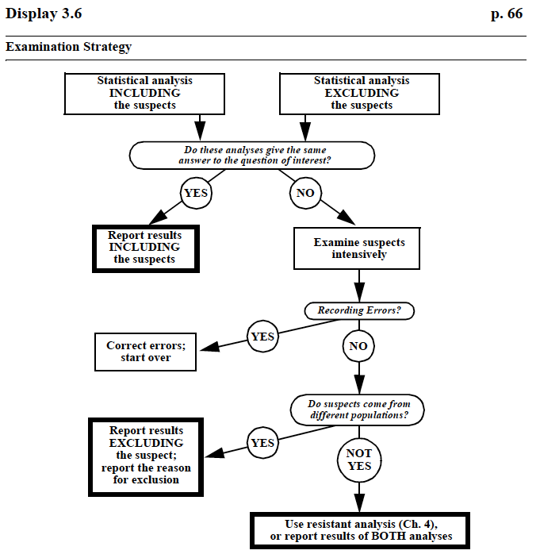
How to deal with outliers

Slide 12
Transformations
Why consider a transformation?
Highly skewed data
‘If the ratio of the largest to the smallest measurement in a group is greater than 10, then the data are probably more conveniently expressed on the log scale’ [Textbook, p. 70]
If the two samples are both skewed, and the group with the larger mean also has larger spread
You will often see recommendations to use a log transform because it ‘makes the data more normal’

Slide 13
Transformations
Why consider a transformation?
Highly skewed data
‘If the ratio of the largest to the smallest measurement in a group is greater than 10, then the data are probably more conveniently expressed on the log scale’ [Textbook, p. 70]
If the two samples are both skewed, and the group with the larger mean also has larger spread
You will often see recommendations to use a log transform because it ‘makes the data more normal’
This isn’t necessarily true, and is an imprecise statement anyway

Slide 14
Logarithms
We will use the natural logarithm (logarithm base e).
The mathematical constant e = 2.71828…
log(x) = y ⬄ e^{y} = x
e.g. log(e) = 1 since e¹ = e
e.g. log(1) = 0 since e⁰ = 1
Some important properties of logs:
log(x) undefined for x < 0
log(x) < 0 for x < 1, log(x) > 0 for x > 1
x > y ⬄ log(x) > log(y) (Monotone increasing)
log(ab) = log(a) + log(b)

Slide 15
Log Transformation
When the data ‘suggest the need for a log transform’ (more later), we define
U_{i} = log(X_{i}) for i = 1, …, m.
V_{i} = log(Y_{i}) for i = 1, …, n.
[Note: the book uses Y_{ij} to represent the log transform of X_{ij}: Y_{ij} = log(X_{ij})]
e.g.
X₁ = 5.1 | U₁ = log(5.1) = 1.63
X₂ = 0.8 | U₂ = log(0.8) = -0.22
X₃ = 2.7 | U₃ = log(2.7) = 0.99

Slide 16
Log Transformation
After log-transforming the data, perform the usual t-test on the transformed values to test hypotheses regarding the means of the transformed variables
For instance, a two-sample t-test performed on U_{i} and V_{i} tests the null hypothesis that the population mean of U_{i} – the population mean of V_{i} is Δ₀.

Slide 17
Log Transformation
IMPORTANT:
If the population mean of the variable X is μ, the population mean of the variable U = log(X) IS NOT log(μ)
Likewise, if the sample mean of X₁, X₂, …, X_{m} is , the sample mean of U₁= log(X₁), U₂ = log(X₂), …, U_{m} = log(X_{m}) IS NOT log( ).
The mean of the logs is not the log of the mean
Therefore, comparing the population means of U and V tells us NOTHING about the population means of X and Y.

Slide 18
Log Transformation
Example:
X_{i} | U_{i} = log(X_{i})
1 | 0
16 | 2.77
20 | 3.00
11 | 2.40
15 | 2.71
Sample Mean of X_{i}: = 12.6 | Sample Mean of U_{i}: = 2.175
log( ) = log(12.6) = 2.53 | e = e^{2.175} = 8.80

Slide 19
Log Transformation
Example:
X_{i} | U_{i} = log(X_{i})
1 | 0
16 | 2.77
20 | 3.00
11 | 2.40
15 | 2.71
Sample Mean of X_{i}: = 12.6 | Sample Mean of U_{i}: = 2.175
log( ) = log(12.6) = 2.53 | e = e^{2.175} = 8.80
Exponentiating the mean of the log-transformed values does not result in the mean of the original values

Slide 20
Log Transformation
Example:
X_{i} | U_{i} = log(X_{i})
1 | 0
16 | 2.77
20 | 3.00
11 | 2.40
15 | 2.71
Sample Mean of X_{i}: = 12.6 | Sample Mean of U_{i}: = 2.175
log( ) = log(12.6) = 2.53 | e = e^{2.175} = 8.80
Taking the log of the mean of the original values does not result in the mean of the log-transformed values

Slide 21
Log Transformation
HOWEVER:
If the population median of the variable X is τ, the population median of the variable U = log(X) IS log(τ)
Likewise, if the sample median of X₁, X₂, …, X_{m} is m, the sample median of U₁= log(X₁), U₂ = log(X₂), …, U_{m} = log(X_{m}) IS log(m).
The median of the logs IS the log of the median

Slide 22
Log Transformation
Example:
X_{i} | U_{i} = log(X_{i})
1 | 0
16 | 2.77
20 | 3.00
11 | 2.40
15 | 2.71
Sample Median of X_{i}: 15 | Sample Median of U_{i}: 2.71

Slide 23
Log Transformation
Example:
X_{i} | U_{i} = log(X_{i})
1 | 0
16 | 2.77
20 | 3.00
11 | 2.40
15 | 2.71
Sample Median of X_{i}: 15 | Sample Median of U_{i}: 2.71
log(15) = 2.71 | e^{2.71} = 15

Slide 24
Log Transformation
Example:
X_{i} | U_{i} = log(X_{i})
1 | 0
16 | 2.77
20 | 3.00
11 | 2.40
15 | 2.71
Sample Median of X_{i}: 15 | Sample Median of U_{i}: 2.71
log(15) = 2.71 | e^{2.71} = 15

Slide 25
Log Transformation
Example:
X_{i} | U_{i} = log(X_{i})
1 | 0
16 | 2.77
20 | 3.00
11 | 2.40
15 | 2.71
Sample Median of X_{i}: 15 | Sample Median of U_{i}: 2.71
log(15) = 2.71 | e^{2.71} = 15
Exponentiating the median of the log-transformed values DOES result in the median of the original values

Slide 26
Log Transformation
Example:
X_{i} | U_{i} = log(X_{i})
1 | 0
16 | 2.77
20 | 3.00
11 | 2.40
15 | 2.71
Sample Median of X_{i}: 15 | Sample Median of U_{i}: 2.71
log(15) = 2.71 | e^{2.71} = 15
Taking the log of the median of the original values DOES result in the median of the log-transformed values

Slide 27
Log Transformation
The book makes the following claims regarding interpretation after a log transformation:
If the log-transformed data have symmetric distributions (big IF),
Mean[log(Y)] = Median[log(Y)]
And since log preserves ordering,
Median[log(Y)] = log[Median(Y)]

Slide 28
Log Transformations
Therefore if the log-transformed data have symmetric distributions (big IF), testing hypothesis regarding the mean of the log-transformed values will provide inference regarding the medians of the original values.
ONLY if the log-transformed data have a symmetric population distribution!

Slide 29
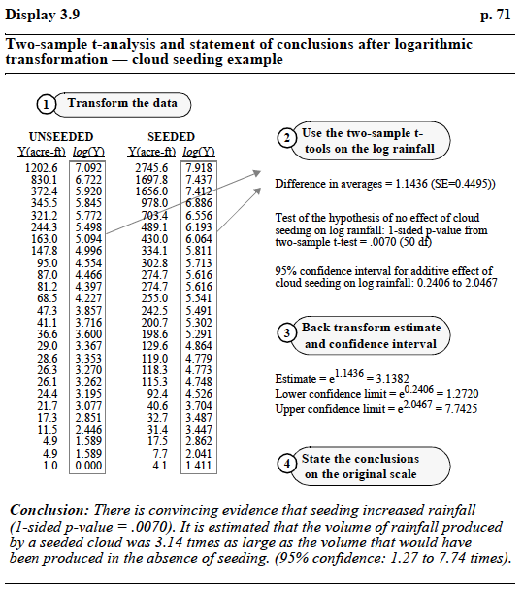
Log Transformations
But what is this ‘estimate’ estimating?
Ratio of medians IF the log transformed distributions are symmetric

Slide 30
(Are you good at identifying symmetric population distributions with a histogram?)

Slide 31
(Are you good at identifying symmetric population distributions with a histogram?)

Slide 32
Log Transformations
Caveats:
CHANGES the questions you are answering
Can be difficult to translate inference back to the original scale (interpretation as geometric mean)
Might not ‘fix’ the ‘problem’ (the log transformed data could still be skewed, perhaps in the opposite direction)
Recommendations:
Consider a log-transformation of your data if you are interested in the log scale (i.e. a multiplicative effect)
Do not try to transform back to medians on the original scale (it is challenging to assess the assumption)

Slide 33
Log Transformations
Caveats:
CHANGES the questions you are answering
Can be difficult to translate/interpret inference back to the original scale (interpretation as geometric mean)
Might not ‘fix’ the ‘problem’ (the log transformed data could still be skewed, perhaps in the opposite direction)
Recommendations:
Consider a log-transformation of your data if you are interested in the log scale (i.e. a multiplicative effect)
Do not try to transform back to medians on the original scale (it is challenging to assess the assumption)
The geometric mean of a set of n numbers is found by:
Taking the product of (multiplying) all the numbers
Taking the n^{th} root of that product

Slide 34
Alternatives to t-test
Two-sample problems first:
Wilcoxon Rank-Sum test
Permutation tests
Welch t-test (unequal variance two-sample t-test)
Paired and one-sample problems next:
Sign test
Wilcoxon Signed-Rank test
(Tests of Population Variances)
Used
Levene’s test

Slide 35
Wilcoxon Rank-Sum Test
Also called:
Rank-Sum test (as in textbook)
Wilcoxon test (but this is ambiguous; we will see the Wilcoxon Signed-Rank test next week)
Mann-Whitney U test
Wilcoxon-Mann-Whitney test
Used to assess ‘difference’ between two populations, using two independent samples.
Setting: Two independent samples (of independent observations)
X₁, X₂, …, X_{m} from population 1
Y₁, Y₂, …, Y_{n} from population 2

Slide 36
Wilcoxon Rank-Sum Test
Procedure:
Combine the samples (keeping track of which observation comes from which sample)
Rank the observations from smallest to largest
Ties must be dealt with by averaging (more later)
Add up the ranks that come from the smaller group
This choice is arbitrary, but simplifies calculations

Slide 37
Wilcoxon Rank-Sum Test
Example:

Slide 38
Wilcoxon Rank-Sum Test
Example:

Slide 39
Wilcoxon Rank-Sum Test
Example:

Slide 40
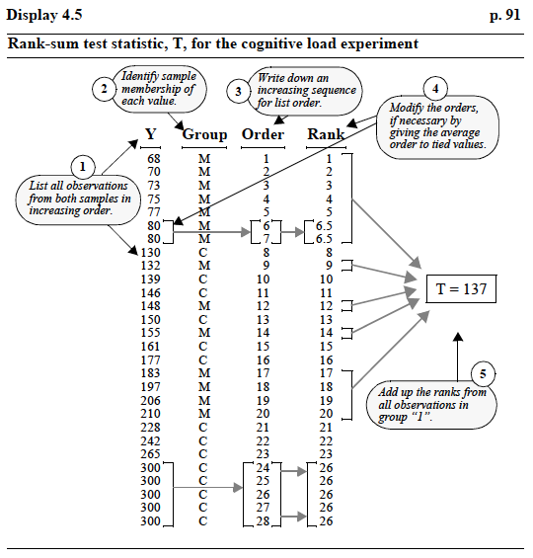
Wilcoxon Rank-Sum Test

Slide 41
Wilcoxon Rank-Sum Test: Reference Distribution
How do we decide whether the result is ‘significant’?
How do we compute p-values?
It is unlikely that all of the small (or all of the large) observations would belong to Group 1 if the two populations have the same distribution.
We can use a permutation approach to decide how unusual our observed test statistic is, if all of the observations come from the same distribution.

Slide 42
Wilcoxon Rank-Sum Test: Reference Distribution
Reference null distribution for the Wilcoxon Rank-Sum statistic T:
If there were no difference between the two groups’ populations, then each rank between 1 and (m + n) would have the same chance of being assigned to the smaller group.
For example, suppose we have m = 4 observations in Group 1 and 7 observations in Group 2 (m + n = 11)
The chance of rank 1 being assigned to Group 1 would be 4/11
The chance of rank 2 being assigned to Group 1 would be 4/11
…
The chance of rank 11 being assigned to Group 1 would be 4/11

Slide 43
Wilcoxon Rank-Sum Test: Reference Distribution
Permute the group assignments and re-compute the test statistic for each permutation to obtain the null distribution
Example: Suppose we observe
Group 1: 4, 17, 12
Group 2: 13, 18, 15, 20
What is the Wilcoxon Rank-Sum test statistic T?
What is the reference null distribution for T?
(What is the distribution of the values of T if each rank has the same chance of being assigned to Group 1)

Slide 44
Wilcoxon Rank-Sum Test: Example
Group | Observed value
1 | 4
1 | 17
1 | 12
2 | 13
2 | 18
2 | 15
2 | 20

Slide 45
Wilcoxon Rank-Sum Test: Example
Group | Observed value | Rank
1 | 4 | 1
1 | 17 | 5
1 | 12 | 2
2 | 13 | 3
2 | 18 | 6
2 | 15 | 4
2 | 20 | 7

Slide 46
Wilcoxon Rank-Sum Test: Example
Group | Observed value | Rank
1 | 4 | 1
1 | 17 | 5
1 | 12 | 2
2 | 13 | 3
2 | 18 | 6
2 | 15 | 4
2 | 20 | 7
T = 1 + 5 + 2 = 8

Slide 47
Wilcoxon Rank-Sum Test: Example
List all possible ways that three ranks could be chosen from the ranks 1, …, 7 for Group 1, and the corresponding value of T_{perm}:
 | T_{perm} |  | T_{perm} |  | T_{perm} |  | T_{perm} |  | T_{perm}
1, 2, 3 | 6 | 1, 3, 6 | 10 | 1, 6, 7 | 14 | 2, 4, 7 | 13 | 3, 5, 6 | 14
1, 2, 4 | 7 | 1, 3, 7 | 11 | 2, 3, 4 | 9 | 2, 5, 6 | 13 | 3, 5, 7 | 15
1, 2, 5 | 8 | 1, 4, 5 | 10 | 2, 3, 5 | 10 | 2, 5, 7 | 14 | 3, 6, 7 | 16
1, 2, 6 | 9 | 1, 4, 6 | 11 | 2, 3, 6 | 11 | 2, 6, 7 | 15 | 4, 5, 6 | 15
1, 2, 7 | 10 | 1, 4, 7 | 12 | 2, 3, 7 | 12 | 3, 4, 5 | 12 | 4, 5, 7 | 16
1, 3, 4 | 8 | 1, 5, 6 | 12 | 2, 4, 5 | 11 | 3, 4, 6 | 13 | 4, 6, 7 | 17
1, 3, 5 | 9 | 1, 5, 7 | 13 | 2, 4, 6 | 12 | 3, 4, 7 | 14 | 5, 6, 7 | 18

Slide 48
Wilcoxon Rank-Sum Test: Example
Resulting reference distribution:
6 | X
7 | X
8 | X X
9 | X X X
10 | X X X
11 | X X X X
12 | X X X X X
13 | X X X X
14 | X X X
15 | X X X
16 | X X
17 | X
18 | X

Slide 49
Wilcoxon Rank-Sum Test: Example
Resulting reference distribution:
6 | X
7 | X
8 | X X
9 | X X X
10 | X X X
11 | X X X X
12 | X X X X X
13 | X X X X
14 | X X X
15 | X X X
16 | X X
17 | X
18 | X
Center (mean/expected value) of null distribution for rank-sum statistics

Slide 50
Wilcoxon Rank-Sum Test: Example
Resulting reference distribution:
6 | X
7 | X
8 | X X
9 | X X X
10 | X X X
11 | X X X X
12 | X X X X X
13 | X X X X
14 | X X X
15 | X X X
16 | X X
17 | X
18 | X
Center (mean/expected value) of null distribution for rank-sum statistics
Average of all possible ranks:
(1 + 2 + 3 + 4 + 5 + 6 + 7)/7 = 4
Expected sum of three ranks:
4 + 4 + 4 = 12

Slide 51
Wilcoxon Rank-Sum Test: Example
Resulting reference distribution:
6 | X
7 | X
8 | X X
9 | X X X
10 | X X X
11 | X X X X
12 | X X X X X
13 | X X X X
14 | X X X
15 | X X X
16 | X X
17 | X
18 | X
How likely is it that if the two populations were identical (i.e. each rank had the same chance of being assigned to Group 1) we would see a value at least as extreme as the observed test statistic value T = 8?
Two-sided test: ‘extreme’ means far from the center, or expected value of T, 12
There are 8 permutations that lead to a rank-sum statistic at least as far from 12 as T = 8.
There are 35 total ways to pick 3 ranks from 7 total observations.
Two-sided p-value: 8/35 = 0.2286

Slide 52
Wilcoxon Rank-Sum Test: Example
Resulting reference distribution:
6 | X
7 | X
8 | X X
9 | X X X
10 | X X X
11 | X X X X
12 | X X X X X
13 | X X X X
14 | X X X
15 | X X X
16 | X X
17 | X
18 | X
How likely is it that if the two populations were identical (i.e. each rank had the same chance of being assigned to Group 1) we would see a value at least as extreme as the observed test statistic value T = 8?
One-sided lower test: ‘extreme’ means small
There are 4 permutations that lead to a rank-sum statistic at least as small as T = 8.
There are 35 total ways to pick 3 ranks from 7 total observations.
One-sided lower p-value: 4/35 = 0.1143

Slide 53
Wilcoxon Rank-Sum Test: Example
Resulting reference distribution:
6 | X
7 | X
8 | X X
9 | X X X
10 | X X X
11 | X X X X
12 | X X X X X
13 | X X X X
14 | X X X
15 | X X X
16 | X X
17 | X
18 | X
How likely is it that if the two populations were identical (i.e. each rank had the same chance of being assigned to Group 1) we would see a value at least as extreme as the observed test statistic value T = 8?
One-sided upper test: ‘extreme’ means large
There are 33 permutations that lead to a rank-sum statistic at least as large as T = 8.
There are 35 total ways to pick 3 ranks from 7 total observations.
One-sided upper p-value: 33/35 = 0.9429

Slide 54
Wilcoxon Rank-Sum Test: Reference Distribution
Reference distribution for larger samples:
When sample sizes are large, it becomes time-consuming to enumerate all possible ways to permute the ranks
We have a few options to approximate the reference distribution:
Select a random sample from all possible permutations
Tables of critical values for small sample sizes, based on permutation distribution
Use a Normal approximation to the reference distribution (next lecture…)

